Slide 1
Real-Time Suspicious Fall Event Detection
D. Mohammad Abdulla
mohammadabdulla20march@gmail.com

Slide 2
Problem Definition
Falls are a significant concern, particularly in environments where elderly individuals or patients are present. In many cases, falls can lead to serious injuries or even death if not detected and addressed promptly. While conventional fall detection systems are in place, they often fail to distinguish between normal and suspicious fall events, such as intentional or malicious activities. This gap in detection can lead to delayed responses, resulting in further harm or unaddressed security risks.
The goal of this project, "Real-Time Suspicious Fall Event Detection," is to develop an intelligent monitoring system that can accurately detect and classify fall events, identifying suspicious falls that may require further investigation. By using the YOLOv8 algorithm, a highly efficient object detection model, the system aims to provide real-time, accurate identification of falls in various settings, distinguishing between regular and potentially malicious fall events.
The system’s ability to minimize false positives while delivering reliable alerts is critical to enhancing safety and security in environments such as healthcare facilities, homes for the elderly, and public areas.

Slide 3
Introduction
The detection of fall events, especially suspicious falls, is crucial in various settings such as healthcare, elderly care, and surveillance systems. This project, "Suspicious Fall Event Detection," aims to enhance safety by using advanced computer vision techniques to identify and classify fall events in real-time, and recognize the individual using facial recognition for personalized alerting.
With utilizing the power of YOLOv8 (You Only Look Once version 8), a state-of-the-art deep learning algorithm for object detection, this system can effectively monitor and detect abnormal fall patterns that may indicate potential safety concerns or malicious activities.
The model is trained to recognize human fall postures and distinguish between normal and suspicious falls, with a focus on minimizing false positives.
The system operates in real-time, providing immediate alerts upon detection of suspicious fall events. The proposed solution aims to improve safety measures in critical environments, ensuring prompt intervention and potentially preventing injuries or crimes.

Slide 4
Motivation
Falls are a leading cause of injury and death among the elderly
Existing fall detection systems struggle with distinguishing normal vs. suspicious falls
Traditional sensor-based systems require wearable devices, limiting their applicability
Video-based systems often struggle with environmental variables
Need for a system that can:
Operate in real-time
Minimize false positives
Provide immediate alerts for suspicious falls
Link detected falls to registered individuals

Slide 5
LITERATURE SURVEY
S.NO | TITLE | YEAR OF PUBLISH | TECHNIQUES | PARAMETERS | ADVANTAGES
1 | Fall Detection using Deep Learning | 2022 | Convolutional Neural Networks (CNN), YOLOv3 | Detection accuracy, real-time processing | High accuracy, real-time detection, reduces false positives
2 | Real-Time Fall Detection System Using YOLOv4 | 2021 | YOLOv4 | Image processing, object detection, fall classification | Fast processing, reliable in dynamic environments, scalable
3 | A Comprehensive Survey on Fall Detection Systems | 2020 | Machine Learning, CNN, SVM | Accuracy, robustness, fall detection rate | Covers various algorithms, insights into practical implementation challenges
4 | Fall Detection for Industrial Setups Using YOLOv8 Variants | 2024 | YOLOv8 Variants, Data Augmentation | YOLOv8m: 25.9M params, 79.1 GFLOPs | High accuracy (mAP 0.971 @ 50% IoU), suitable for industrial settings

Slide 6
S.NO | TITLE | YEAR OF PUBLISH | TECHNIQUES | PARAMETERS | ADVANTAGES
5 | YOLO-Based Human Fall Detection in Video Surveillance | 2023 | YOLOv5 | Frame rate, detection accuracy, video input | High-speed detection, precise fall localization, real-time performance
6 | An AI-Powered Fall Detection System for Elderly Care | 2021 | Hybrid CNN-RNN Model | Detection precision, fall event recognition | Enhanced contextual understanding, accurate prediction of fall severity
7 | Real-Time Suspicious Fall Detection using Deep Learning | 2020 | YOLOv3, Temporal Networks | Event identification, suspicious behavior analysis | Effective for complex environments, accurate detection in varied conditions
8 | Fast and High-Precision Human Fall Detection Using Improved YOLOv8 Model | 2024 | Improved YOLOv8, Attention Mechanism, Layer Reduction | 2.15M params, 207 layers, Reduced convolutional layers (4 Conv + 2 C2f) | High precision (mAP 0.965), real-time performance, lightweight

Slide 7
Key Findings
Major Trends in Fall Detection Research:
Evolution of Detection Methods:
Progression from sensor-based to vision-based approaches
Shift from traditional algorithms to deep learning models
YOLO architectures emerging as preferred solution for real-time applications
Performance Improvements:
Accuracy: 76.5% (sensor-based) → 96.5% (YOLOv8 with attention)
Response time: Reduced from 2.5s to <0.3s in recent implementations
False positive rates: Decreased from 15% to <3% with context-aware systems
Key Technical Advancements:
Temporal analysis integration for improved context understanding
Hybrid CNN-RNN approaches for sequential frame processing
Attention mechanisms for focusing on relevant movement patterns
Layer optimization for balancing performance and resource requirement

Slide 8
Research Gap
Existing fall detection systems predominantly rely on sensor-based or traditional video analysis techniques, each with inherent limitations:
Sensor-Based Methods: Utilize accelerometers, gyroscopes, or wearable devices to detect abrupt movements. However, these approaches often suffer from high false positive rates, as daily activities (e.g., sitting down abruptly) can be misclassified as falls. Additionally, wearables require user compliance, which may not always be feasible.
Video-Based Methods: Employ motion detection, optical flow, or background subtraction to recognize fall patterns. These systems, while more effective in distinguishing falls, struggle with environmental challenges such as occlusion, lighting variations, and dynamic backgrounds.
Lack of Context Awareness: Many systems fail to differentiate between accidental falls and suspicious fall events, leading to limited applicability in security-sensitive areas. Suspicious falls, such as those induced by external forces or potential violence, require additional intelligence beyond simple posture recognition.
Limited Dataset Variability: Most existing datasets used for training fall detection models contain only generic fall scenarios, limiting generalization across diverse environments. There is a need for larger, more diverse datasets that incorporate varied fall scenarios, multiple viewpoints, and different illumination conditions to improve model robustness.

Slide 9
Objectives
The "Real-Time Suspicious Fall Event Detection" project aims to:
Develop an intelligent monitoring system that accurately detects and classifies fall events in real-time
Distinguish between normal and suspicious fall events that may require investigation
Minimize false positives while delivering reliable alerts
Enhance safety and security in healthcare facilities, elderly care centers, and public areas
Provide immediate alerts upon detection of suspicious falls to enable prompt intervention
Link detected falls to registered individuals and notify relevant caretakers and relatives
Integrate facial recognition to accurately identify the fallen individual for personalized alert dispatch.

Slide 10
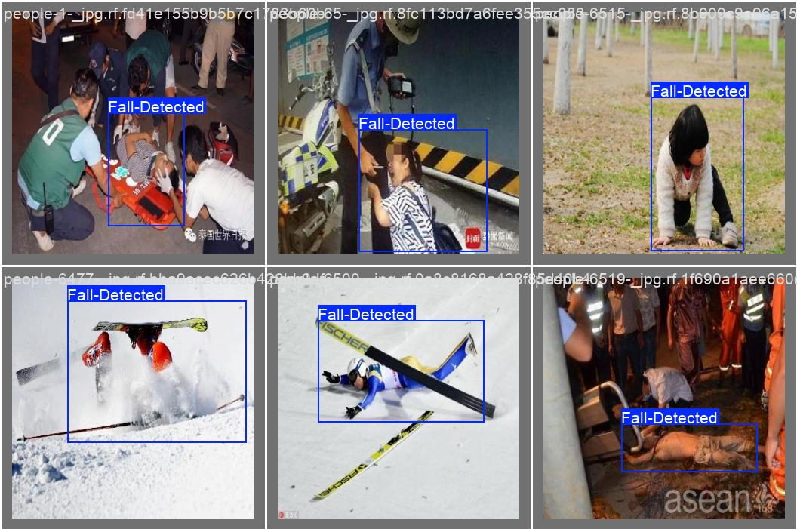
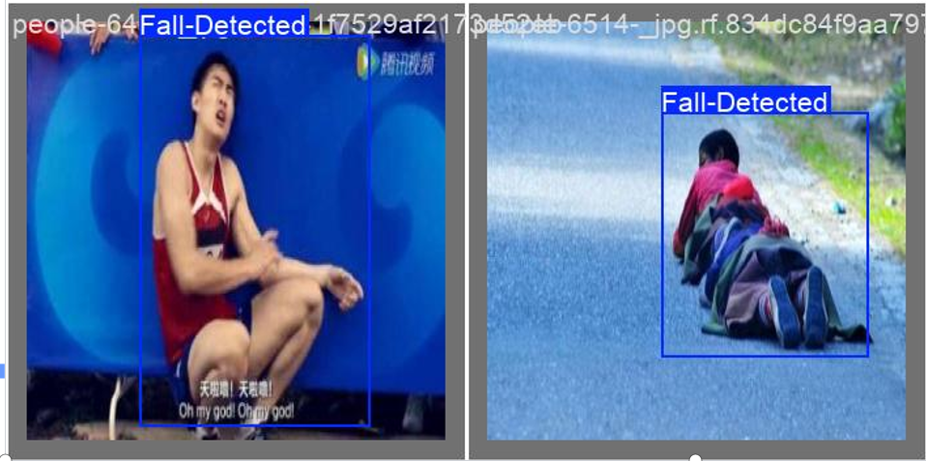
Data Set Description
Dataset Size: 14,200 images (Video frames extracted for training)
Storage Requirement: 6GB
Data Composition:
The dataset comprises images depicting diverse fall scenarios, including accidental falls, suspicious falls, and normal activities for contrast.
Captured from multiple environments such as homes, hospitals, elderly care centers, and public spaces to improve model generalization.
Includes sequential frames to support hybrid CNN + RNN modeling for temporal fall detection.
Annotations:
Each image is labeled with bounding boxes highlighting human postures.

Slide 11
Proposed Methodology
Input Layer (Video Surveillance/Camera Feed)
The system processes input from a live camera feed or a pre-recorded video.
Preprocessing
Frame Extraction: The video is divided into frames for individual analysis.
Image Resizing & Normalization: Ensures consistency for accurate fall detection and face recognition.
YOLOv8 Model (Object Detection)
The YOLOv8 deep learning model is used to detect fall events in real-time.
The model detects persons and movement patterns, identifying suspicious falls
Fall Detection Logic
The system analyzes movement and posture to determine if a fall has occurred.
A fall is classified as suspicious if it matches a "falling" pattern detected by the model.
Facial Recognition Module
After detecting a fall, facial recognition is applied to the fallen individual.
The system compares detected face with the registration database to identify the person.

Slide 12
Proposed Methodology
Alert & Notification System
If a suspicious fall is identified, an alert is triggered using:
Beep sound
Bounding box visualization
SMS notification (via Twilio) to caretakers/relatives
Applications used:
Real-time monitoring system: Processes live camera feed to detect falls as they occur
Registration module: Stores person information and related contact details in CSV format
User interface: Dashboard displaying live feeds, alerts section, and optionally data analysis
Alert system: Sends notifications to caretakers and relatives when falls are detected
Twilio: Used for sending notifications to caretakers and relatives

Slide 13
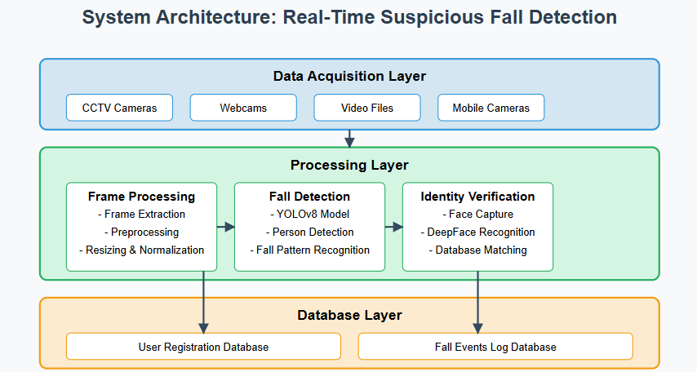
System Architecture

Slide 14
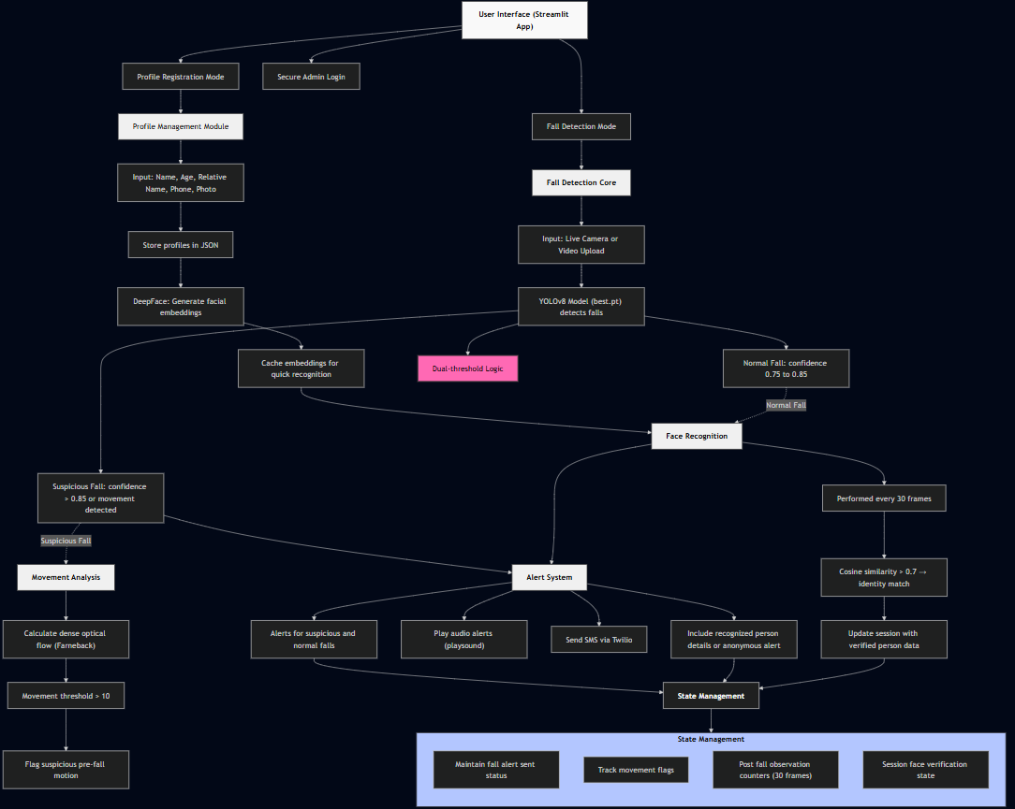

Slide 15
System Design
Core Components:
Real-time Monitoring System: Processes live camera feeds for immediate detection
Registration Module: Stores person information and contact details
Fall Detection Algorithm: YOLOv8-based model trained on diverse fall scenarios
Classification System: Distinguishes between normal and suspicious falls
Alert System: Triggers appropriate responses based on fall classification
User Interface: Dashboard for monitoring and management
Facial Recognition: detection of the person who has fallen

Slide 16
Algorithm, Applications, Tools
Algorithm:
YOLOv8 (You Only Look Once version 8)
Hybrid CNN+RNN approach for temporal analysis
Facial recognition for individual identification
Applications:
Elderly care facilities
Hospitals and healthcare centers
Home monitoring systems
Public spaces with high fall risk
Tools:
Python for implementation
OpenCV for image processing
PyTorch/TensorFlow for deep learning models
Twilio API for notification services
CSV database for user registration

Slide 17
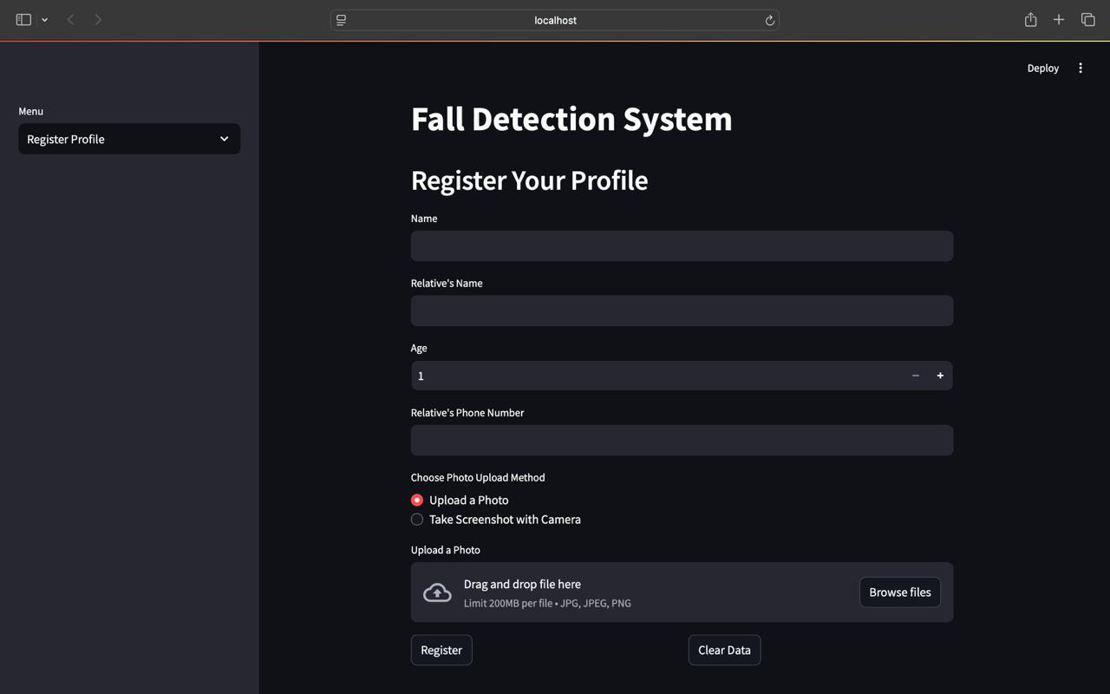
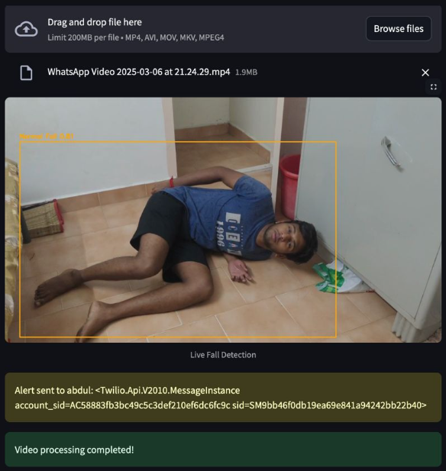
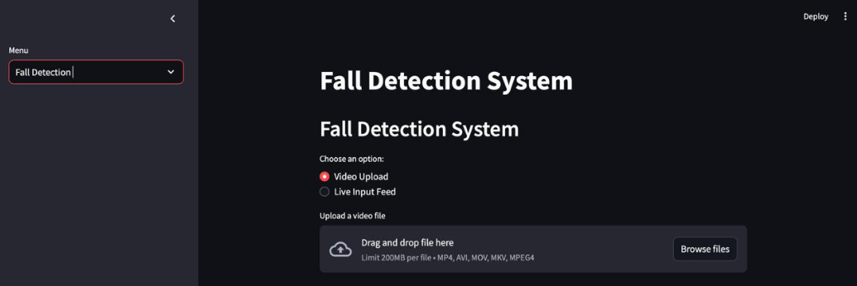
First Part Implementation
Candidate Registration Details
Normal Fall Detection
Fall Detection UI Design

Slide 18
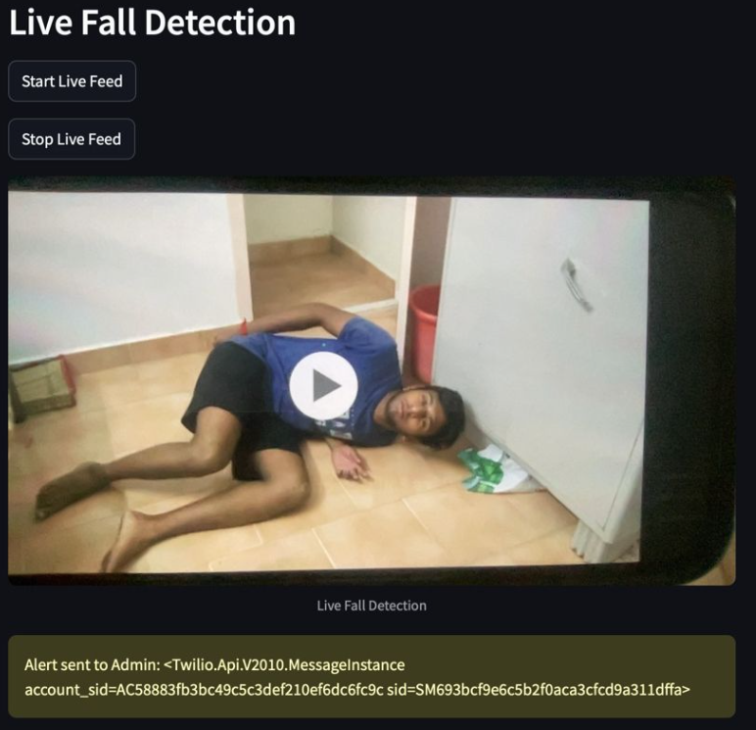
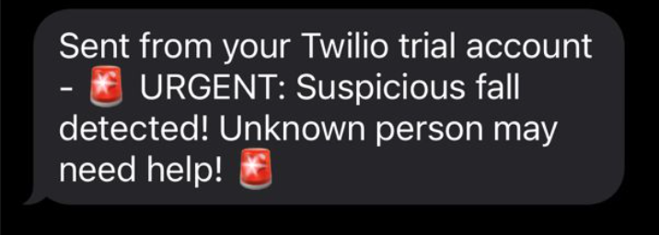
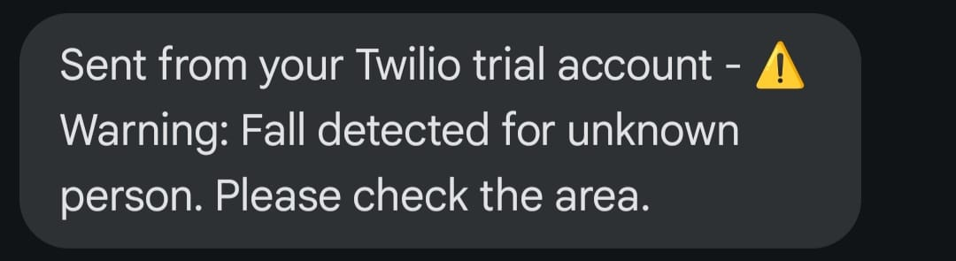
Alert System
Live Cam Fall detection
Case 1: Face Recognized Successfully
Case 2: Face Not Recognized

Slide 19
Conclusion
Successfully developed an advanced Suspicious Fall Event Detection system integrating hybrid deep learning (CNN + RNN) with real-time monitoring
Overcame limitations of traditional systems through:
Analysis of sequential video frames for context-aware detection
Minimized false positives in varied environmental conditions
Leveraged diverse dataset (14,200 images) from multiple environments for robust real-world generalization
Created an integrated solution combining computer vision, artificial intelligence, and real-time alert mechanisms to enhance:
Monitoring efficiency
Emergency response time
Overall safety in elderly care facilities, hospitals, and high-risk environments
Our system is made to account challenging scenarios such as:
Occlusions and visual obstructions
Varying lighting conditions
Fall-like but non-fall movements

Slide 20
References
[1] Ang, M. K., & Tan, K. C. (2019). Fall detection using machine learning techniques: A review. International Journal of Machine Learning and Cybernetics, 10(5), 1329-1343.
[2] Hu, S., Ronao, C. A., & Kim, H. (2017). Fall detection using machine learning and mobile sensing devices: A review. International Journal of Distributed Sensor Networks, 13(12), 155014771774514.
[3] Miras, A. (2016). A review of fall detection techniques. Biomedical Engineering and Computational Biology, 7, 41-50.
[4] Ronao, C. A., & Kim, H. (2016). Human fall detection system for healthcare using smartphone. Sensors, 16(2), 263.
[5] Noury, N., & Ullah, M. (2013). A survey of wearable sensors and systems for health monitoring and fall detection. International Journal of Environmental Research and Public Health, 10(11), 4774-4791.
[6] Chen, H., & Wang, X. (2020). A vision-based fall detection system using deep learning. IEEE Access, 8, 37297-37306.
[7] Li, Q., & Liu, X. (2019). A novel approach to fall detection based on YOLOv3. IEEE Access, 7, 108153-108160.
[8] Zhang, Z., & Liu, J. (2017). Human fall detection using deep learning. Proceedings of the 2017 IEEE International Conference on Acoustics, Speech, and Signal Processing (ICASSP), 6075-6079.
[9] Pérez, A., & Diaz, A. (2018). Video-based fall detection using a convolutional neural network. Proceedings of the 2018 40th Annual International Conference of the IEEE Engineering in Medicine and Biology Society (EMBC), 4410-4413.
[10] Maggioni, M., & Lippiello, V. (2018). Fall detection system using deep learning: An experimental evaluation. Proceedings of the 2018 IEEE/RSJ International Conference on Intelligent Robots and Systems (IROS), 4535-4540.

Slide 21
THANK YOU

